Slide 1

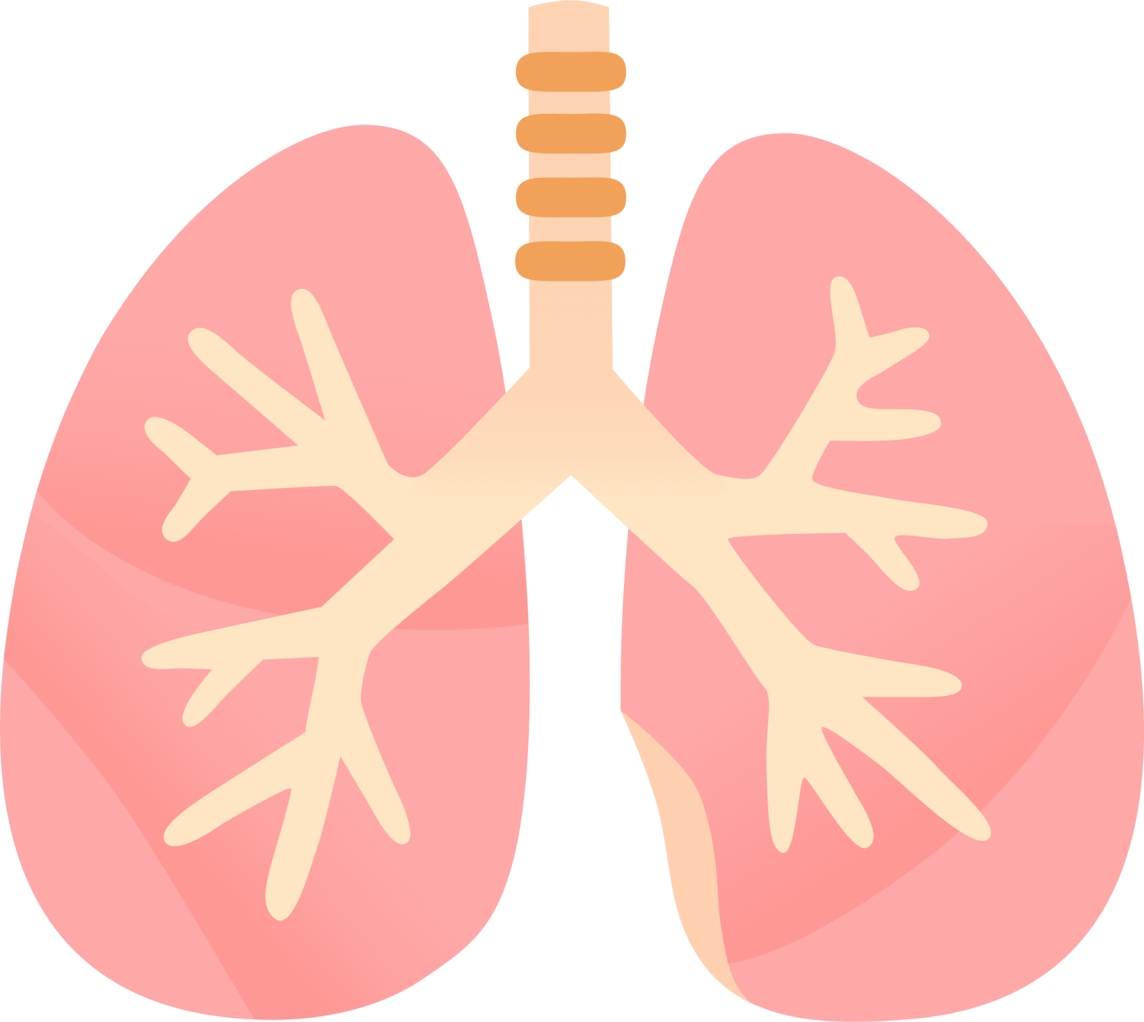
LUNG SOUND RECORDER
Team: Quad-Core Squad
By: Karthik, Aryanil, Anurag, and Adithya
Professor: Abhishek Srivastava
TA: Santhoshini
Week-3

Slide 2
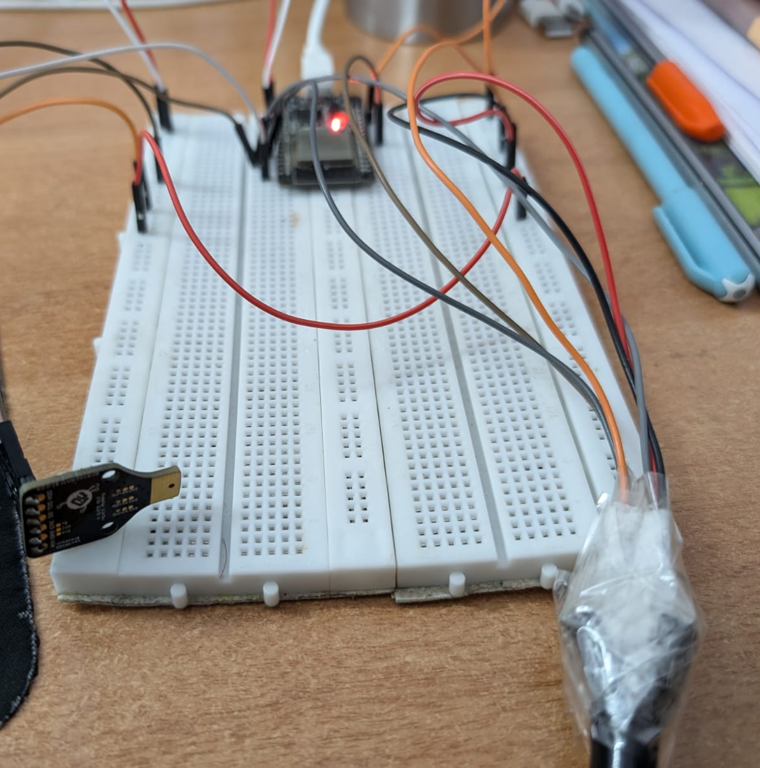
Hardware setup
We connected 2 breadboards together to create an enlarged base.
We attached the ESP32 to the breadboard, then made connections to put the sensors in place.
ESP32
MAX30205
INMP441

Slide 3
Recording using ESP32

Slide 4
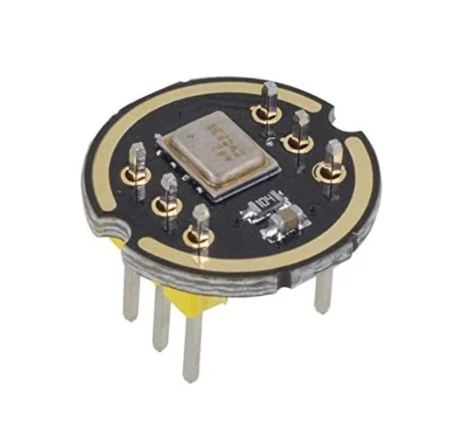
INMP-441
Digital I2S interface with high precision 24-bit data
High signal to noise ratio is 61 dBA
High sensitivity – 26 dBFS
Stable frequency response from 60 Hz to 15 kHz
Low power consumption: low current consumption 1.4 mA

Slide 5
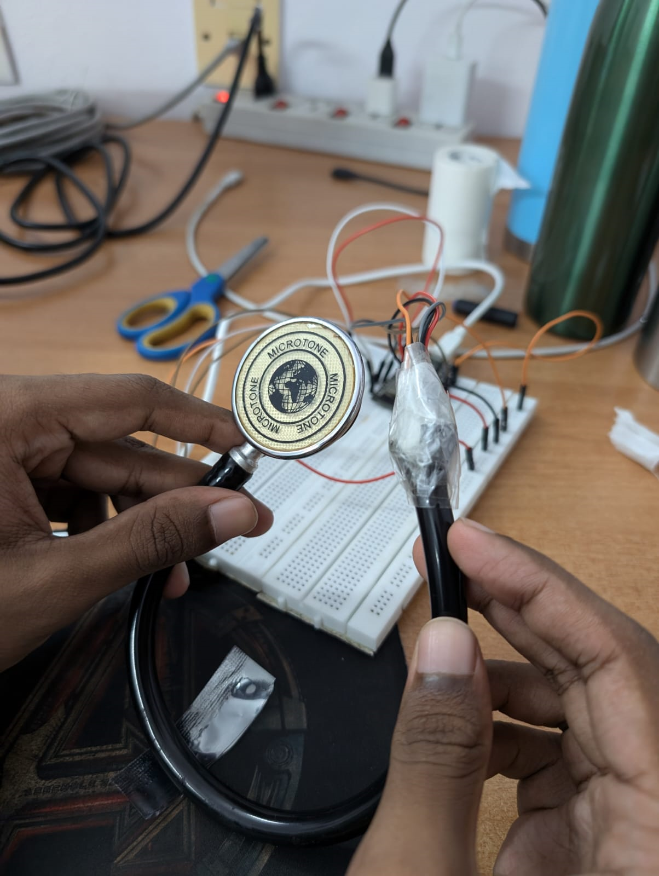
Experimental setup
Stethoscope head
INMP441
We cut the stethoscope, and proceeded to make slits on it
We used two types of tape, medical tape to secure the wiring, and cello tape to reduce noise

Slide 6
Features of the Recording Code
The code records sound and creates a wav file representing the audio. This is stored in the ESP’s memory.
This code allows us to change sample rate, sample bits, and time spent recording.

Slide 7
Features of the Web server Code
The code hosts a webserver on the ESP, allowing us to access the filesystem of the ESP.
We can visit the webserver to download the recorded .wav file, which we can then pass into python.

Slide 8
Code
Recording code can be found at:
https://github.com/AryanilPanja/lung_sound_recorder/blob/main/mic_recording_github.ino
Webserver code can be found at:
https://github.com/AryanilPanja/lung_sound_recorder/blob/main/FSBrowser.ino

Slide 9
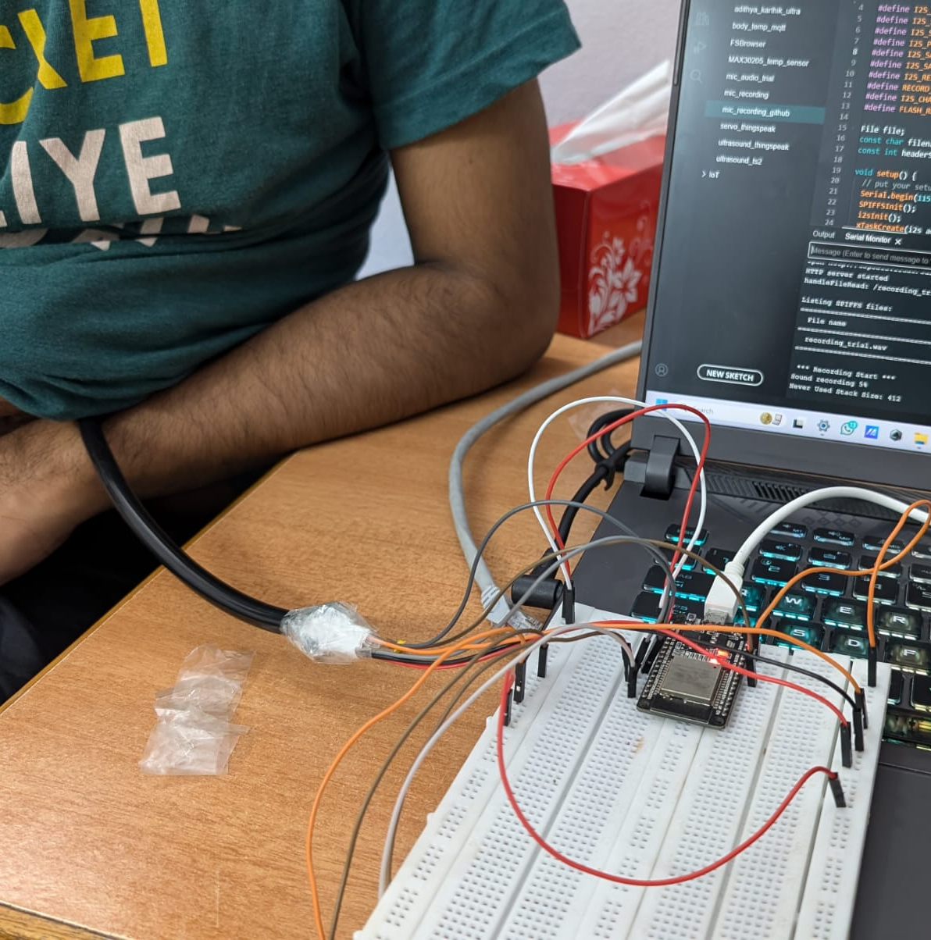
First Trial
We tried to get heartbeat/ lung sounds using the new setup, using a human test subject.
We tried putting the stethoscope on the shirt, but that did not give adequate results.
We then tried direct skin contact.
Stethoscope head
INMP441
ESP32

Slide 10
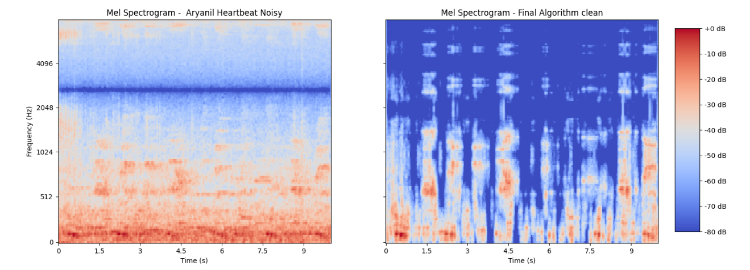
The sound that we recorded was noisy and we could barely hear any heartbeats/lung sounds even after filtering.

Slide 11
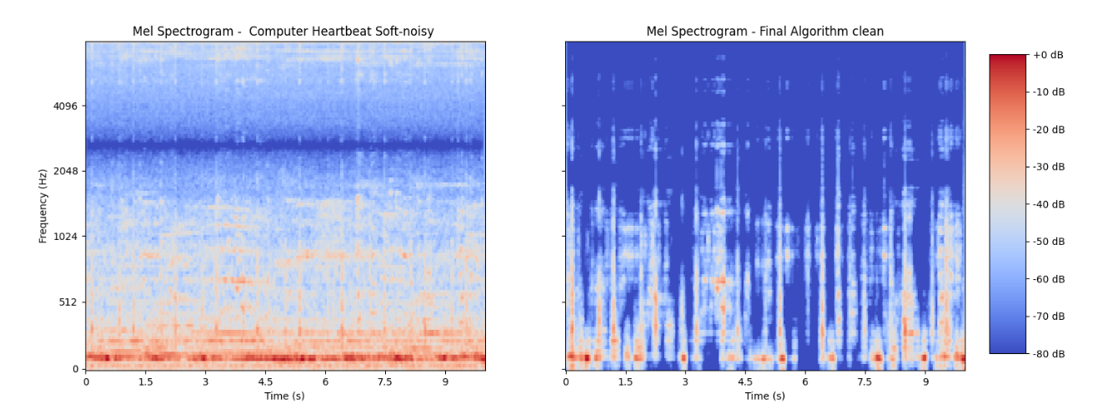
Computer Generated Heartbeat

Slide 12
Observations
There were no discernable heartbeats from the sound recorded from skin contact. After filtering, although the noise was reduced, there were still no discernable heartbeats.
The heartbeats recorded from the computer could be heard, and after filtering were clear.

Slide 13
Classification of the sound files using an AI model

Slide 14
CNN vs SVM model
CNN generally outperforms SVM by effectively learning spatial hierarchies in image data, while SVM may require complex feature engineering and can struggle with larger datasets.
Therefore, CNN would serve as a better image classifier.

Slide 15
CNN model
The HF lung sound dataset consists of .wav files which are 1D audio waveform data.
We have 2 choices: We can either obtain the spectrograms from the .wav files and apply a 2D CNN model or we can directly apply the 1D CNN model on the dataset.

Slide 16
References
https://peyrone.medium.com/comparing-svm-and-cnn-in-recognizing-handwritten-digits-an-overview-5ef06b20194e
https://www.kaggle.com/code/mersico/understanding-1d-2d-and-3d-convolution-network
https://www.kaggle.com/code/arbazkhan971/image-classifications-in-5-steps-for-beginner

Slide 17
Future Steps
We can try to use different materials to insulate the microphone from external noise. (silicone tube, etc.)
Start working on the CNN/SVM to classify sounds.

